Slide 1

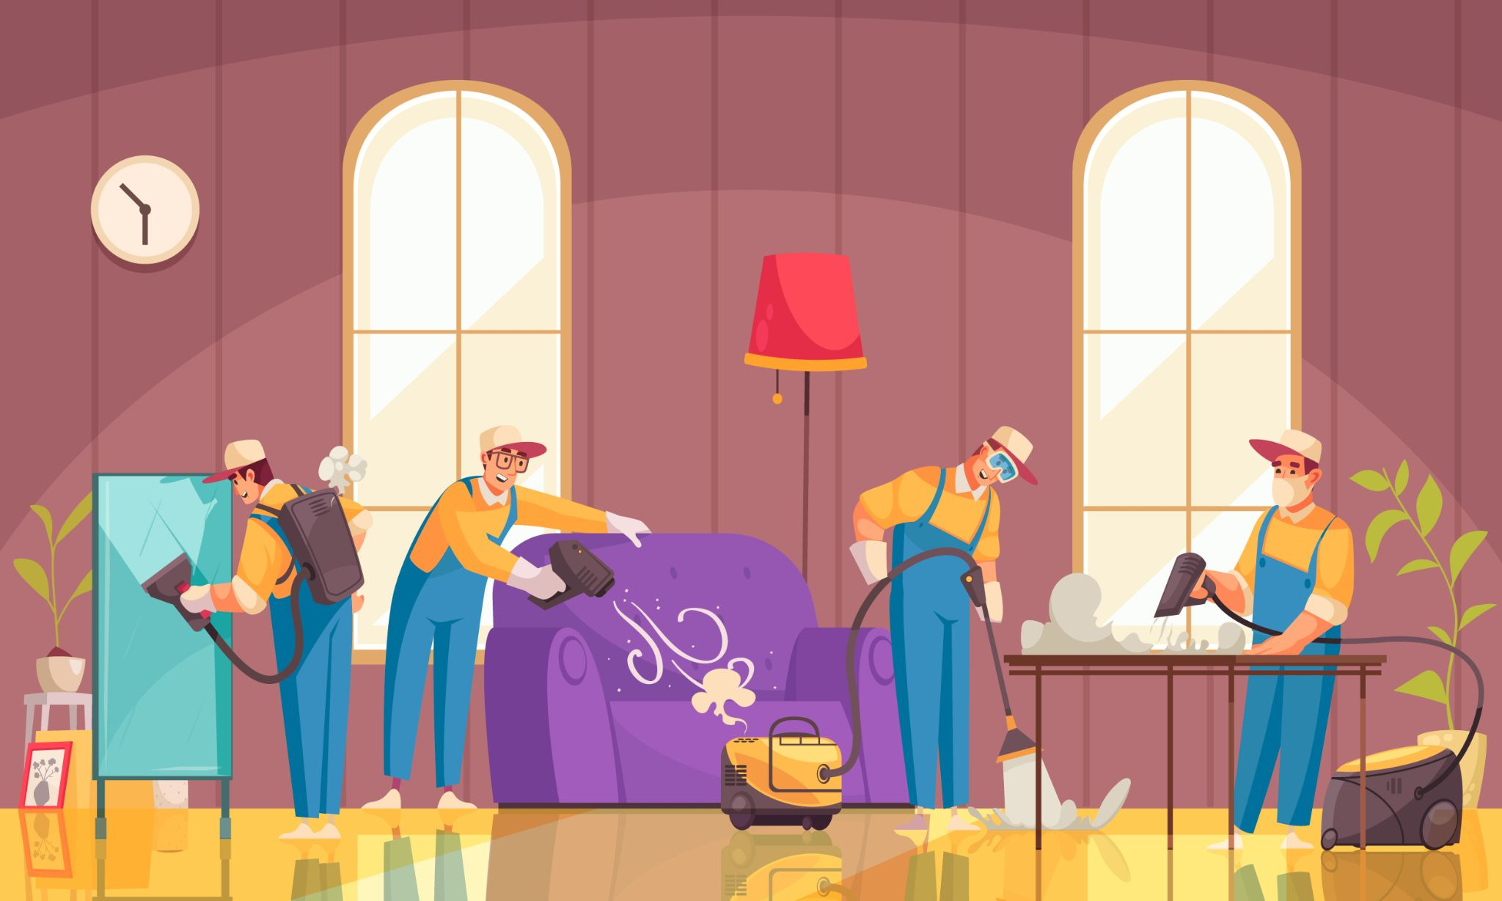
hausKeepr
Let’s get cleaning!
Luis
Nell-e
Patrick
Abel

Slide 2
01
01
Our mission
Economic Empowerment
Create a Community of Skilled Housekeepers
Gain Life and Work Balance for Busy Professionals

Slide 3
01
Description of the app
Describe the Application

Slide 4
Tell Your User Story

Slide 5
Tell Your User Story
AS A …
I Want…
So That…

Slide 6
We will have icons on this slide for the presentation
Unmute
Start Video
Invite
Participants
Share Screen
Chat
Record
Tools that we used
Other resources

Slide 7

demonstration
Allow Us To Do The Work

Slide 8


Hauskeepr creators

Slide 9
02
Blah Blah Blah

Slide 10
Blah Blah Blah
Blah
Blah
Blah

Slide 11
Blah blah blah
Blah blah blha
Blah
B;ah

Slide 12
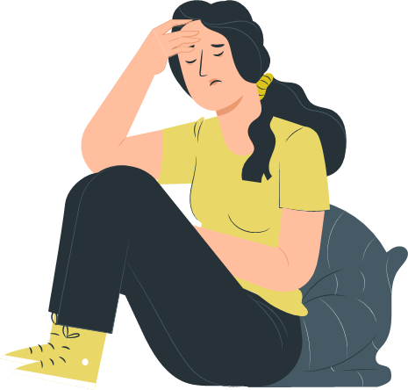
Find yourself a hauskeepr
Blah blah blah
blah
Blah blah blah

Slide 13
Find yourself a hauskeepr
Blah blah blah
Blah blah blah
Blah blah blah

Slide 14
Blah blah blah
Blah blah
B;ah b;a h b’ah
Blah blah
Blah blha

Slide 15
Providing housekeeping services in the bay area

Slide 16
Hauskeepr technologies used

Slide 17
What ever I can think of to put on here for hauskeepr

Slide 18
COLLABORATE!

Slide 19
Blah blah section
Write here your request
Write here your request
Write here your request
Write here your request
Write here your request
Write here your request

Slide 20
What else can I think of to add to these slides for hauskeepr
Select
Select
Select
Select
Select
Select

Slide 21
COOL!
This will be the place for lessons learned during the development of the project.

Slide 22
AWW...
Opportunities that worked for the team during the development of this project

Slide 23
oops!
Challenges theKeeprs faced during the development of the project

Slide 24
hauskeepng
How we handled the challenges

Slide 25
Use for wireframes
Write here your idea
Write here your idea
Write here your idea
Write here your idea
Write here your idea
Write here your idea
Write here your idea
Write here your idea
Write here your idea

Slide 26
More talk about the team
Blah blah challenges
Blah blah what worked
Blah blah blah
Blah blah blah

Slide 27
Future development

Slide 28
Future development

Slide 29
Segregation of duties
Keepr | Task 1 | Task 2 | Task 3
Abel | Write here | Write here | Write here
Luis | Write here | Write here | Write here
Patrick | Write here | Write here | Write here
Nell-E | Write here | Write here | Write here

Slide 30
What else is there in the template for the presentation for project 2.
TIP: ​what are the things that worked.

Slide 31
COMBINE GRAPHICS

Slide 32
COMBINE GRAPHICS AND LINKS
See the results

Slide 33
FILLING OUT TABLES
Day 1 | Day 2 | Day 3 | Day 4 | Day 5
2
4
3
1
2
1
3

Slide 34
We wanted to share our picture to the class ☺

Slide 35
Project management tools we used for the hauskeepr project
Miro
Slack
Trello

Slide 36
Communications

Slide 37
Review our concepts and how things work for the hauskeepr

Slide 38
We prepare for the finale

Slide 39
Work it
Additional resources we used during the project

Slide 40
ICONS ARE ALWAYS USEFUL
Despite being red, Mars is cold
The Sun is the star at the center of the Solar System

Slide 41
SOME CLOSING WORDS
To:
Everyone
More
Type message here...

Slide 42
— theKeeprs
“The Only way We can All Truly Connect is When We Begin To Clean This World Together As One.”

Slide 43
THANKS!
Please visit our Heroku link to the app and our Github Repository:
Github.com
For more information please contact theKeeprs:
+91 620 421 838
theKeeprs.com

Slide 44
04
Goodbye! ☺

Slide 45
ALTERNATIVE RESOURCES

